Slide 1
Maze Navigation Using LiDAR Scans
Maor Amitai, Yair Vax
Project presentation · August 2026

Slide 2
The Task and the Approach
The task
The approach
Why it is hard
Navigate a robot through a two-dimensional maze from point A to point B — without ever being told its own position or the position of the goal.
Replace explicit (x,y) coordinates with sequences of LiDAR readings. A diffusion model plans directly in scan space; a localizer converts scans back into positions only for control.
Giant mazes are made of long, self-similar corridors, so many different places produce almost identical scans. The core difficulty is ambiguity, not control.
Constraint: the planner never sees x or y, in any form, at any point — every position it acts on is inferred from the sensor.

Slide 3
Technical Architecture
STAGE 1
STAGE 2
Diffusion planner
Executor
Generates a trajectory of future LiDAR scans from a start scan and a goal scan.
inverse-dynamics model mapping current scan → desired scan into joint torques.
Environment: OGBench AntMaze Giant, then PointMaze Giant Stitch. Everything runs on comp_diffuser_release.

Slide 4
Project Timeline
Kickoff
Navigate a 2-D maze from A to B with (x,y) input.
Localization
3-D pose grid (x, y, θ), likelihood maps, candidate ranking.
Pivot to the ball + keep improving ant.
Verify and hop, improving ant movment, fixing goal localization.
LiDAR port
Lidar scans replace (x,y). simulated laser, dataset conversion, retrained diffusion and inverse dynamics.
Ant improvements and plateau
End-to-end tops out near 10%. Goal-scan ambiguity, not control, is the binding constraint.
Ball: Viterbi + budget
Viterbi decode lifts @1000 from 19.0 to 45.2. Step budget corrected to OGBench's 1000.

Slide 5
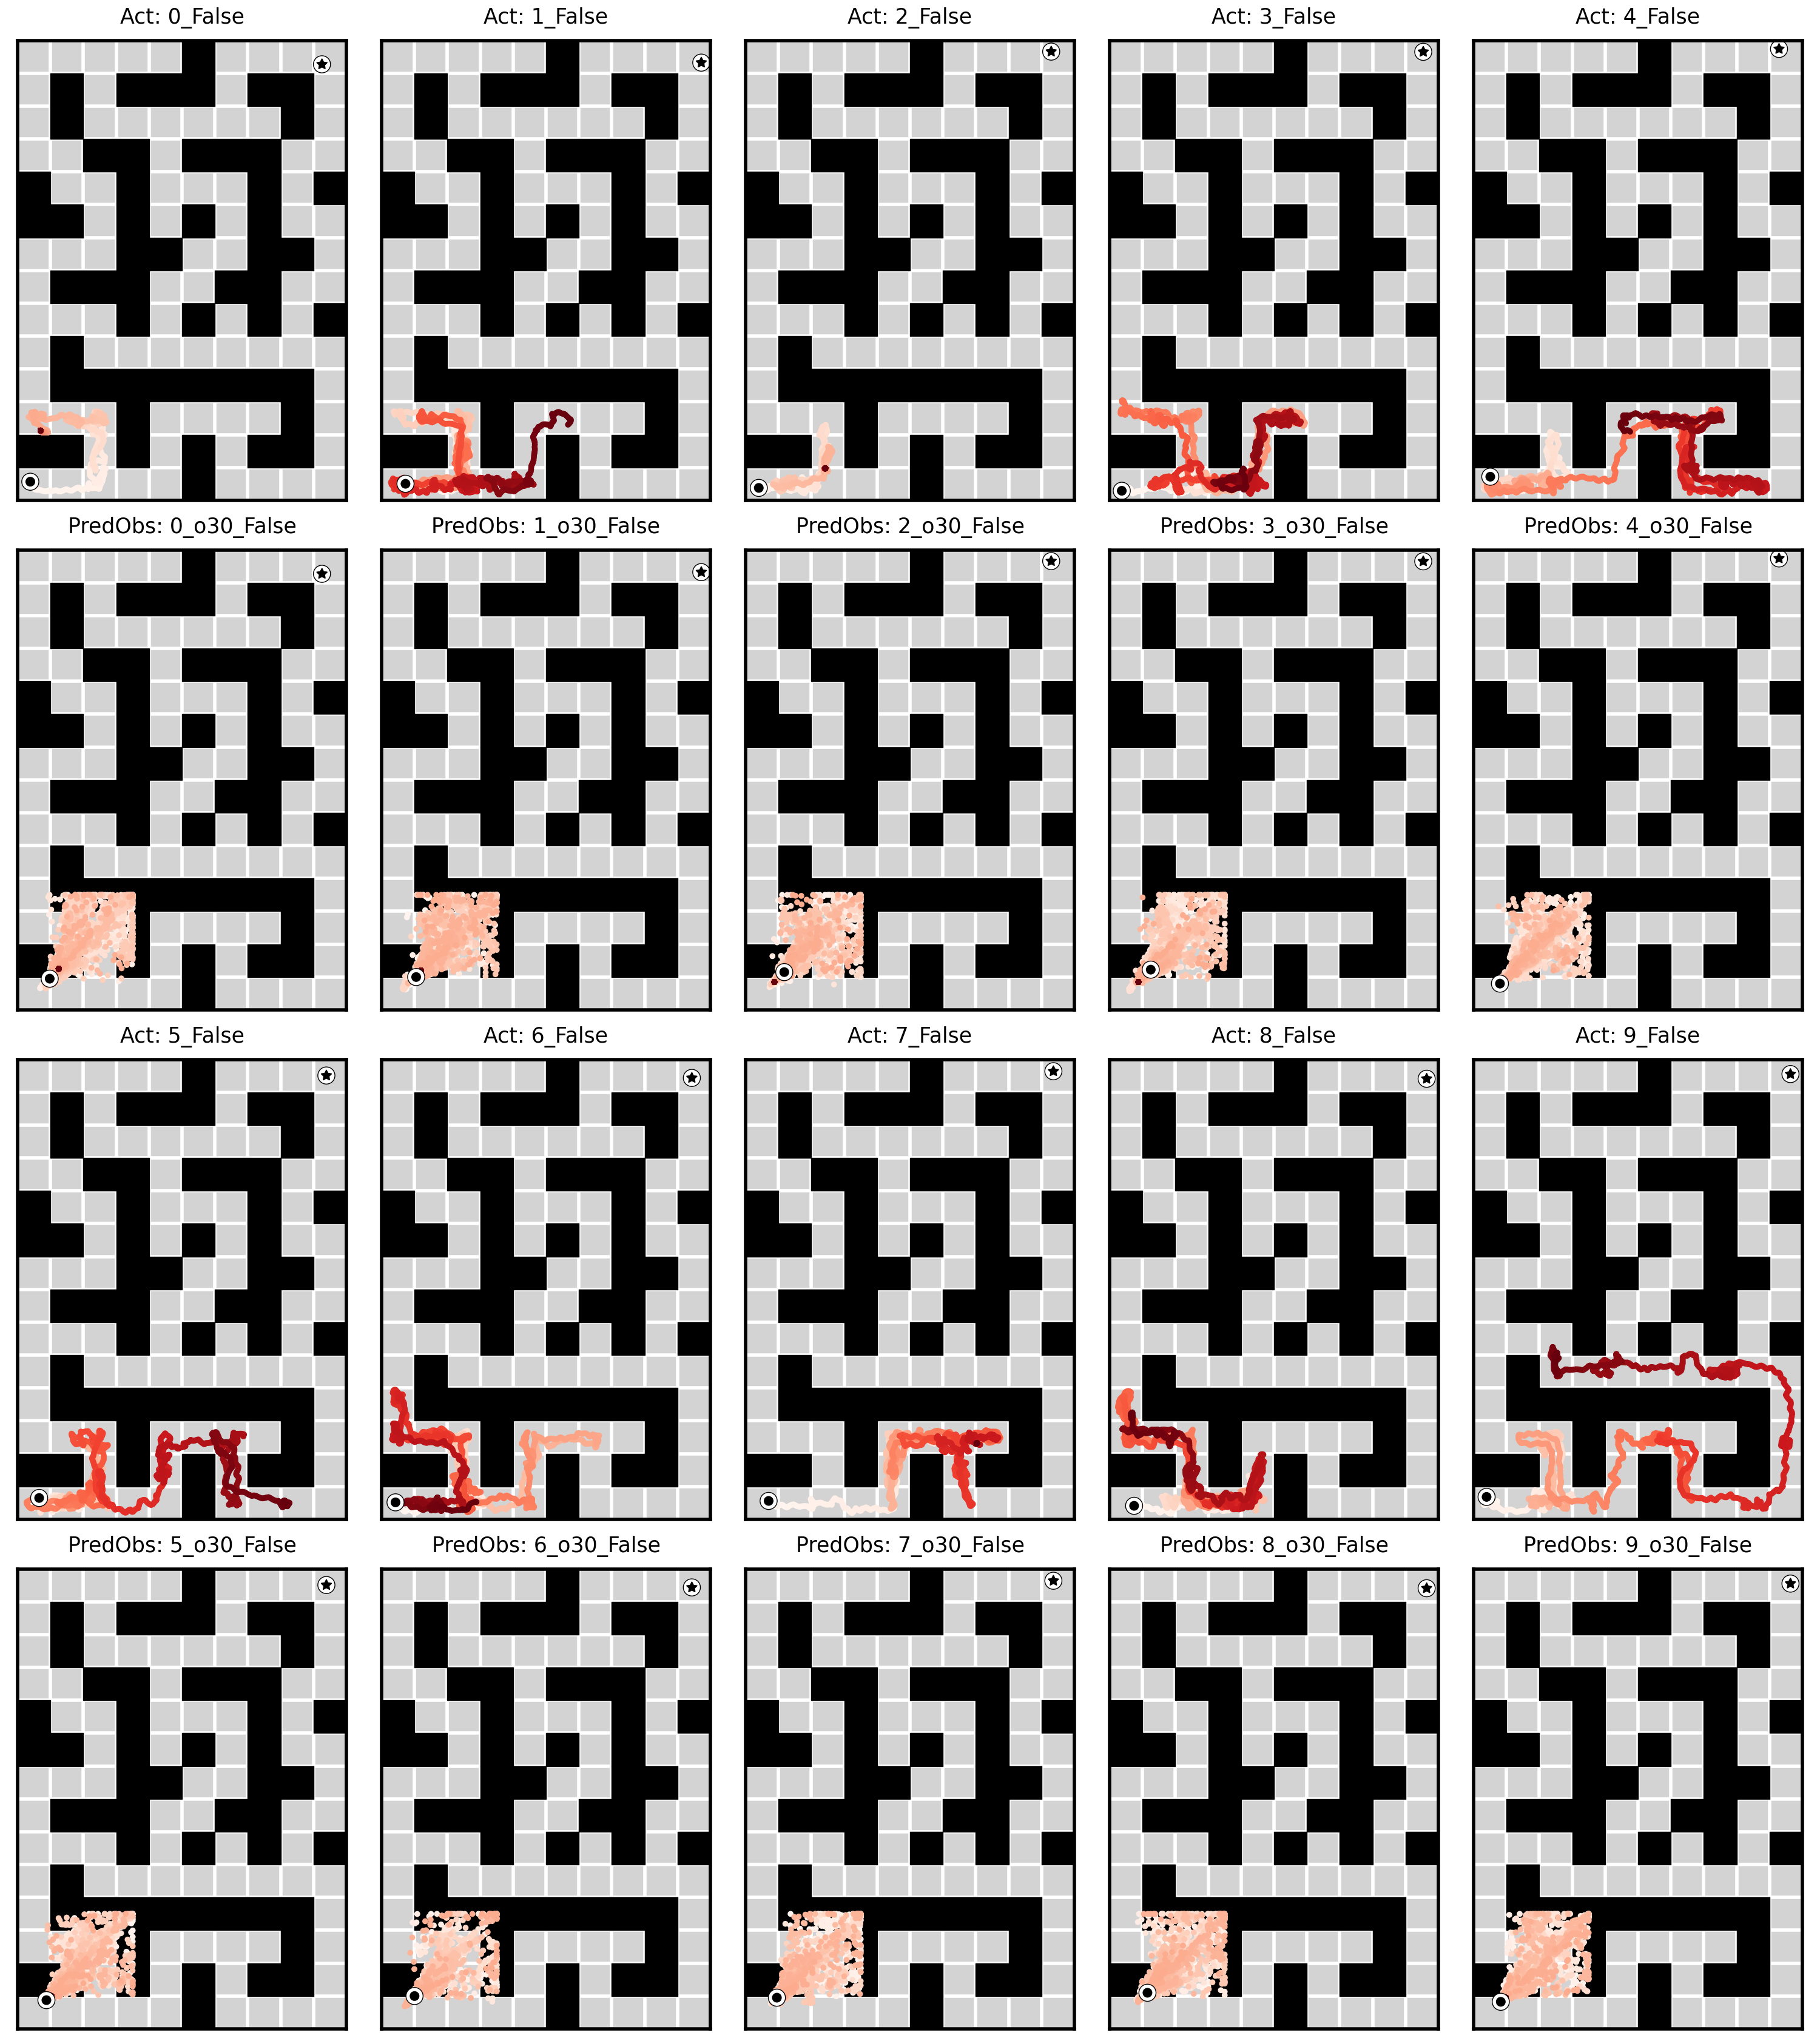
The First Result After the LiDAR Port: 0%
The first end-to-end run on AntMaze Giant with (x,y) replaced by LiDAR scans reached the goal in none of the episodes
0%
Success rate after the port
AntMaze Giant · scans in place of coordinates
WHAT WAS ALREADY WORKING
Dataset conversion, simulated laser, retrained diffusion planner and inverse dynamics — the pipeline ran end to end.
WHAT WE DID NOT YET KNOW
Why it was zero. Perception, control and goal ambiguity were all still stacked on top of each other.

Slide 6
First Problem: The Ant Would Not Move
The inverse dynamics model never saw the ant's joint angles — restoring them lifted action-prediction R² from 0.26 to 0.88
THE PROBLEM
The inverse dynamics model was missing the joint angles of the ant's legs. The robot did not move at all.
THE SOLUTION
Reconstruct the missing joint angles and feed them in as part of the input vector to the model.
THE RESULT
The robot actuated — the ant starts walking. First purposeful motion in the environment.
0.26
0.88
R² before the fix
Poor prediction of the required actions
R² after the fix
Dramatic improvement in action prediction

Slide 7
The Central Problem: Goal Ambiguity
LOW UNIQUENESS
SIGNAL, NOT SKILL
One scan is not an address
The ability is there
In a maze of long, self-similar corridors, a single LiDAR scan taken from the goal cell is not unique. different cells produce an almost identical scan.
when the top-scoring plan happens to sit in the right cell, routing is correct. It just is not reliable.
Diagnosis: the bottleneck is the representation of the goal and the movement of the ant, not the planner's capacity to produce a route.

Slide 8
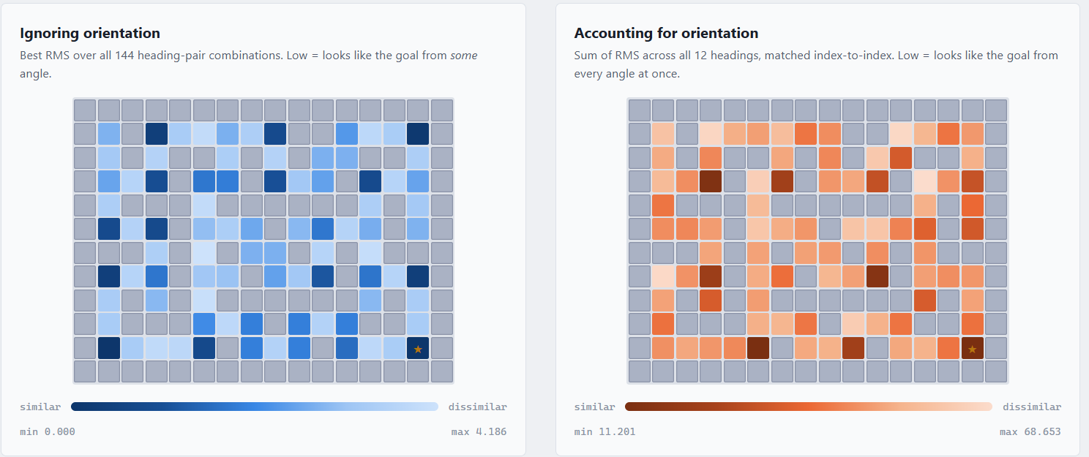
Goal Ambiguity Visualization

Slide 9
Attempted Fix: Multi-Scan Goal
Replace the single goal scan with a short approach sequence — retraining succeeded, the maze still did not get solved
Replace the single goal scan with a short sequence of K scans taken as the agent approaches the goal.
THE IDEA
The approach sequence encodes spatial context — which should have resolved the goal-representation ambiguity.
THEORETICAL ADVANTAGE
Retraining went through successfully, but the robot still failed to solve the maze.
THE ACTUAL RESULT

Slide 10
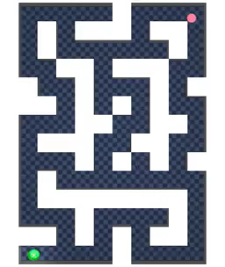
First Success!
A 3-D (x, y, θ) localization grid over the maze led to the first end-to-end success
WHAT MADE IT WORK
We built a 3-D grid over (x, y, θ): one copy of the map per heading, stored as rows × columns × orientations. Headings sit about 30° apart to match the scan data, and the grid resolution keeps a run to a few minutes.
0% → ~10%
End-to-end success rate, AntMaze Giant

Slide 11
Lifting The Success Rate
Target: lift the success rate from 10% toward the 60% of the original (x,y) diffuser
Change | What it did | Result
Verify and hop | Use the ranked candidate list as a fallback plan instead of committing to one guess. | 2 / 20
Scanning every 10° | 36 orientation bins instead of 12, to recognise the goal cell more often. | Worse — 65% of true cells missed the list entirely
Better ant movement | When the ant is stuck in place, head for the most open direction and replan. | 4 / 20 — slight improvement
Fixed goal-cell localization | Deduce the goal cell from 12 scans at the true goal and compare it against every other cell (MSE-like), instead of from an approach sequence. | 50% with orientation, 39% without
Less replanning | Replan only when needed, instead of unconditionally every 500 steps. | 46% — slightly worse; 4,500 → 4,000 steps
Net effect: the goal-cell fix carried almost all of the gain — 10% to ≈39%/50%; every other knob was flat or negative.

Slide 12
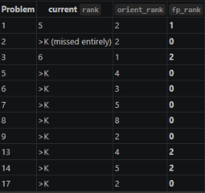
Candidate List After Fixed goal-cell Localization

Slide 13
Ant Aftermath
SECTION 02
Ant aftermath

Slide 14
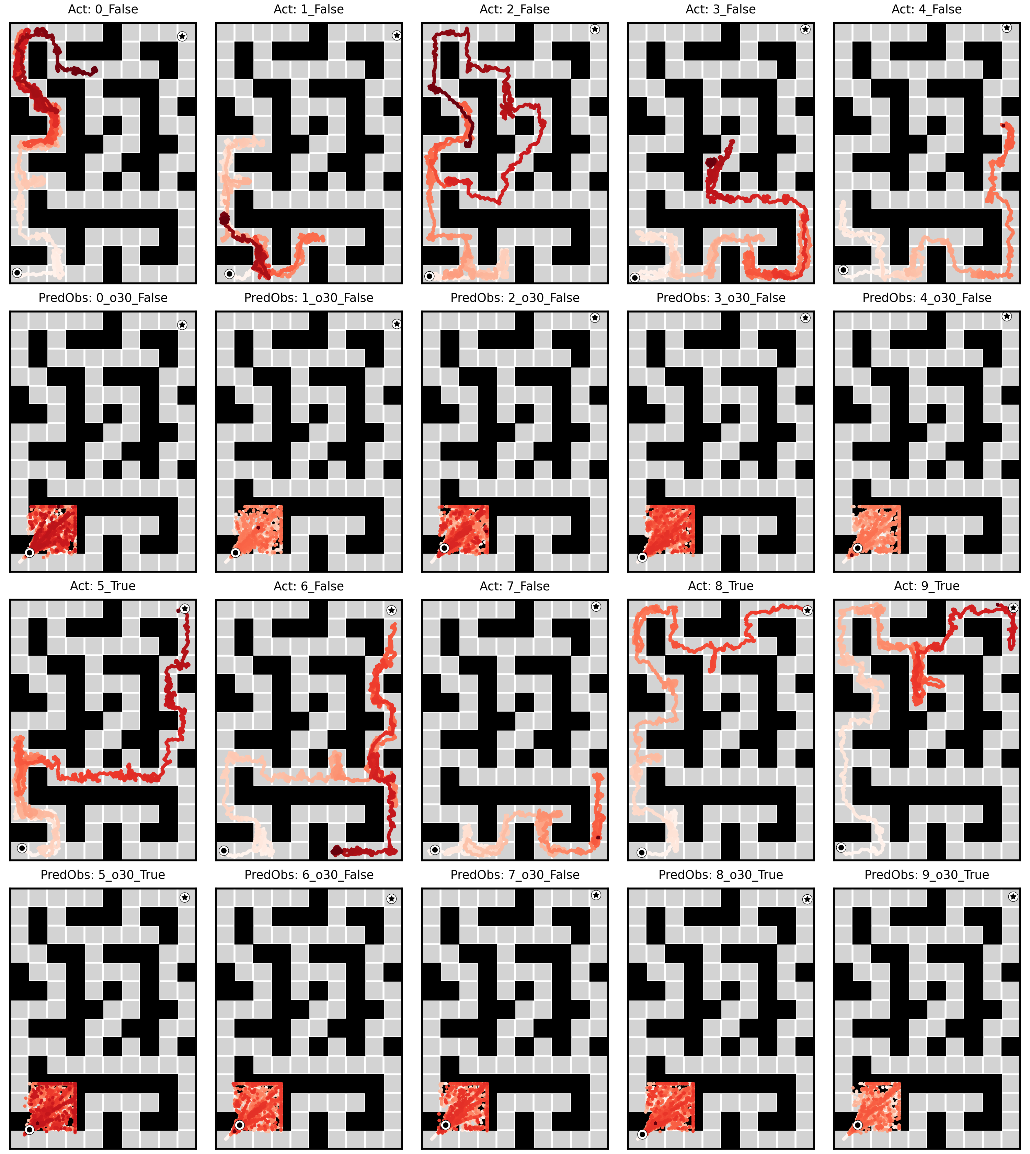
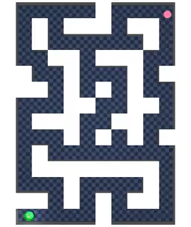
Example of a few runs
aliasing
In this batch of runs, most of the time the first contender was aliased to a different similar cell.
- the first contender

Slide 15
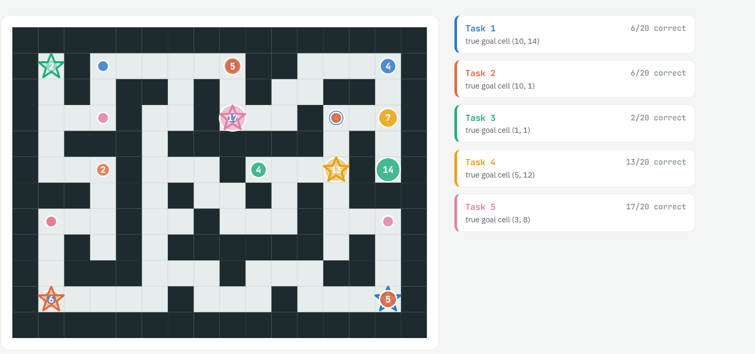
Aliasing Map

Slide 16
The Ball
SECTION 03
True-LiDAR on the ball
PointMaze giant-stitch — a point mass that navigates from 30 range beams alone

Slide 17
Why We Moved to the Ball
THE REASON
WHAT IT REMOVES
WHAT SURVIVES
The ant plateaued
No heading, no learned executor
Goal-scan aliasing
End-to-end success topped out near 10%, with three failure sources stacked on top of each other: control, self-localization and goal ambiguity.
A point mass has no orientation, so scans are a pure function of position and the reference grid drops from 12 angular bins to 1. OGBench drives it with a proven P-law.
The one hard problem is unchanged: different places still produce near-identical scans. That is geometry, not agent — and it is the science we wanted to study.
Both perception channels now measure free. Reading LiDAR instead of the state costs nothing measurable; the whole remaining gap is planner and executor.

Slide 18
The Pipeline
01
02
03
04
05
Sensor
Planner
Decode
Pursuit
Executor
A 30-beam scan, full 2π field of view, 12 wu max range, raycast against the true maze map. Yaw is identically zero.
Composed diffusion in 30-D scan space. 8 segments × 160 frames, overlap 56, giving an 888-frame scan plan. Start and goal scans inpainted.
A Viterbi localizer over a grid of 4,409 poses. Max-product over whole paths turns the scan plan into (x,y) carrot targets.
BFS waypoints plus a cursor: an argmin over a 61-index forward window, 2 wu of plan arc ahead, line-of-sight checked.
PID with Kp = 5, bit-identical to upstream's proven P-law. Saturated on roughly 90% of steps.
Belief runs alongside. A sequence-consistent grid filter localizes the ball every step from its live scan, seeded from the start scan; the same likelihood machinery localizes the goal scan.

Slide 19
The Viterbi Decode: Most Impactful Improvement
Max-product over paths replaced per-step argmax in the plan decode — zero retraining, CPU-only, +26 pts @1000 steps
THE FAULT
The filter decode took the argmax independently at every step, so it emitted carrot targets the ball physically could not follow. 89% of the steps where the ball came off its plan sat on one — 8% null, lift 10.6x, p = 1.7e-137.
THE FIX
Max-product over paths on the 4,409-pose grid (0.5 wu lattice). It removes 100% of the infeasible carrots and lowers the scan-match residual — the model's scans were always better explained by a continuous path.
19.0 → 45.2
57.0 → 77.6
@1000 steps · +26.2 pts
p = 1.2e-24 — the headline number
@2500 steps · +20.6 pts
p = 6.2e-20 — historical budget

Slide 20

Where We Stand
500 episodes per arm (5 tasks × 20 problems × 5 seeds). Success latches, so budget buys score.
45.2 ± 0.8
Ours @1000 steps
Viterbi, 5 seeds × 100 problems
68 ± 3
CompDiffuser (paper)
(x,y) obs + learned inverse dynamics
−22.8 pts
Gap to close
~29 pts of it is recoverable time

Slide 21
The Eval Ladder Is Flat
Each rung adds exactly one error source — so we can price each one separately
Rung | Goal comes from | Position from | Isolates | @2500, 3 seeds
L1 | True goal scan | True (x,y) | Planner + decode quality | 55.0 ± 6.6
L2 | Likelihood-decoded goal cell | True (x,y) | Goal localization | 55.0 ± 5.3
L3 — the deliverable | Decoded goal cell | Belief filter | Self-localization (full True-LiDAR) | 57.0 ± 5.0
L4 | Both modes | Both | Planner-free BFS ceiling | 0% (last-mile, stale)
Both perception steps are free. Goal localization: 165 vs 165, p = 1.0, with 55/100 episodes bit-identical. Self-localization: 171 vs 165, p = 0.57, median error 0.260 wu on a 0.5 wu lattice.

Slide 22
Half the Budget Produces No Motion
51% of the first 1,000 control steps move the ball zero world units — there is no “slow”, only stopped or at max speed
Where the first 1,000 steps go | Share | Counterfactual @1000
Moving — always at max speed (0.200 / 0.283 wu) | 49.3% | —
A-idle — frozen, carrot sitting on the ball | 17.7% | 51.4
B-pinned — frozen, carrot far, PID saturated | 32.9% | 64.2
Both removed — same plans, model and decode | 50.7% | 74.2
A is pursuit geometry, not visibility. 57% of idle steps had a visible point within 2 wu of plan arc and idled anyway.
A tangent almost always exists. 85% of pinned steps have a free beam ≥1 wu wide still pointing goal-ward.

Slide 23
New Approch: Frequent Replanning With History Taken Into Account
The decoder matches each scan to the grid on its own, so every new plan is decoded without the ball's history
A memoryless argmin: for each scan it picks the grid point whose reference scan is most similar, with no link to previous frames.
HOW THE DECODER WORKS
The ball gets teleported. Each fresh plan is decoded from scratch, with nothing tying it to where the ball has just been.
WHAT HAPPENS ON REPLAN
History is the missing input. We tried several workarounds; feeding history in is hard because the decoder we chose cannot use it. We see this as a future direction.
OUR ASSESSMENT

Slide 24
Summary
WHAT WE TRIED
ANT · ANTMAZE GIANT
BALL · POINTMAZE GIANT
Plan in scan space
0% → ≈39–50%
45.2% @1000 steps
We replaced (x,y) with LiDAR scans: a diffusion planner generates a trajectory of scans, and a localizer decodes it back into positions the agent can follow.
Restoring joint angles, a 3-D (x, y, θ) pose grid and a goal-cell fix took the ant from 0% to its best result. Goal-scan aliasing set the ceiling.
The Viterbi decode lifted success from 19.0% to 45.2% (77.6% @2500), against 68% for CompDiffuser with (x,y) input.

Slide 25
Additional Things We Can Try
1 · CHEAPEST
2 · STRUCTURAL
Finish the frozen-time arms
Rewrite the pursuit fixed point
Arms 2 and 3 are shipped but unrun. Screen one seed per arm, read the mechanism gate before the score, then 5 seeds on any winner. Ceiling +19.0 pts.
The cursor only advances when the ball moves. Advance on plan index against elapsed time, or project the ball onto the plan polyline. ~40 lines plus one screening job.
3 · OWED
4 · THE SCIENCE
Re-run the offline suite
Attack the planner residual
Every G2a/G2b number was computed with the decode we later proved was emitting teleports. CPU-only, existing dumps — tells us whether “the planner is incoherent” is still true.
Blocks 0 and 1 hold plans that genuinely go elsewhere; no timing fix touches them. Replan cadence first, then the one sensing lever still live for block 1.

